Slide 1
SUSTech Lambda 1th pre
team member: 朱恒成 王雨童 张思宇 何海滨 张兆旭

Slide 2
目录
CONTENTS
01
02
03
04
05
Motivation
&
Requirements
Feature
Description
Design
Document
Techniques
TimeLine

Slide 3
Motivation& Requirements

Slide 4
Motivation&
Requirements
Motivation
Functional requirements
The website provides a platform for executing command.
• The designer can upload their own scripts to server
• The user pass the parameters by the website and then the server
execute the script
• The superuser can manage all users and scripts

Slide 5
Feature Description

Slide 6
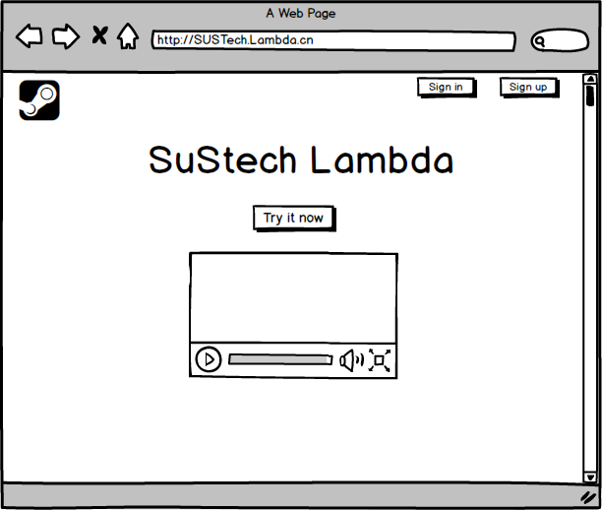
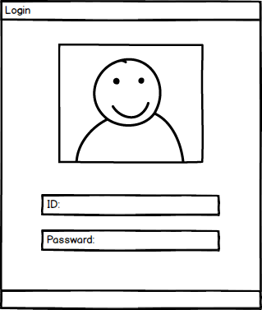
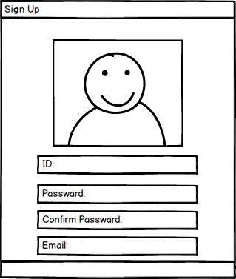
UI
home page
log in(using dialog)
sign up(using dialog)

Slide 7
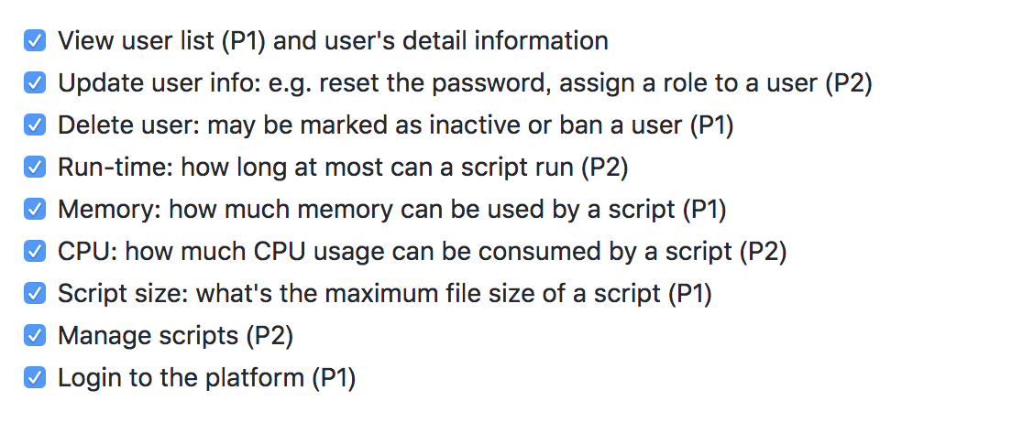

User story for Super user
国内外研究概况

Slide 8
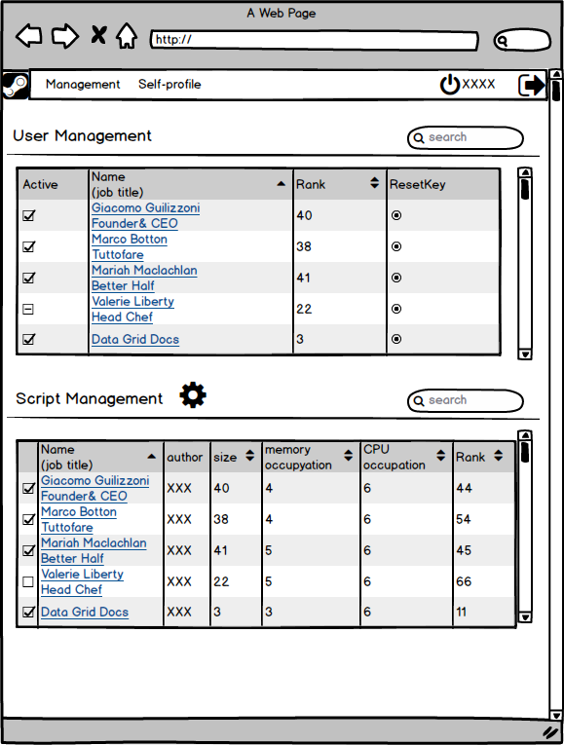
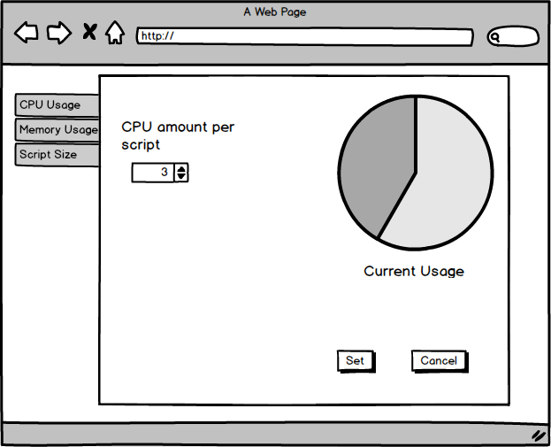
UI
Superuser&Manage

Slide 9
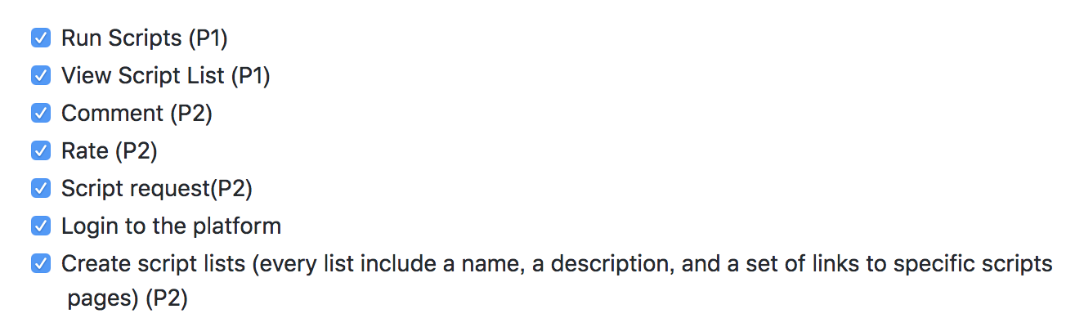

User story for script user
国内外研究概况

Slide 10
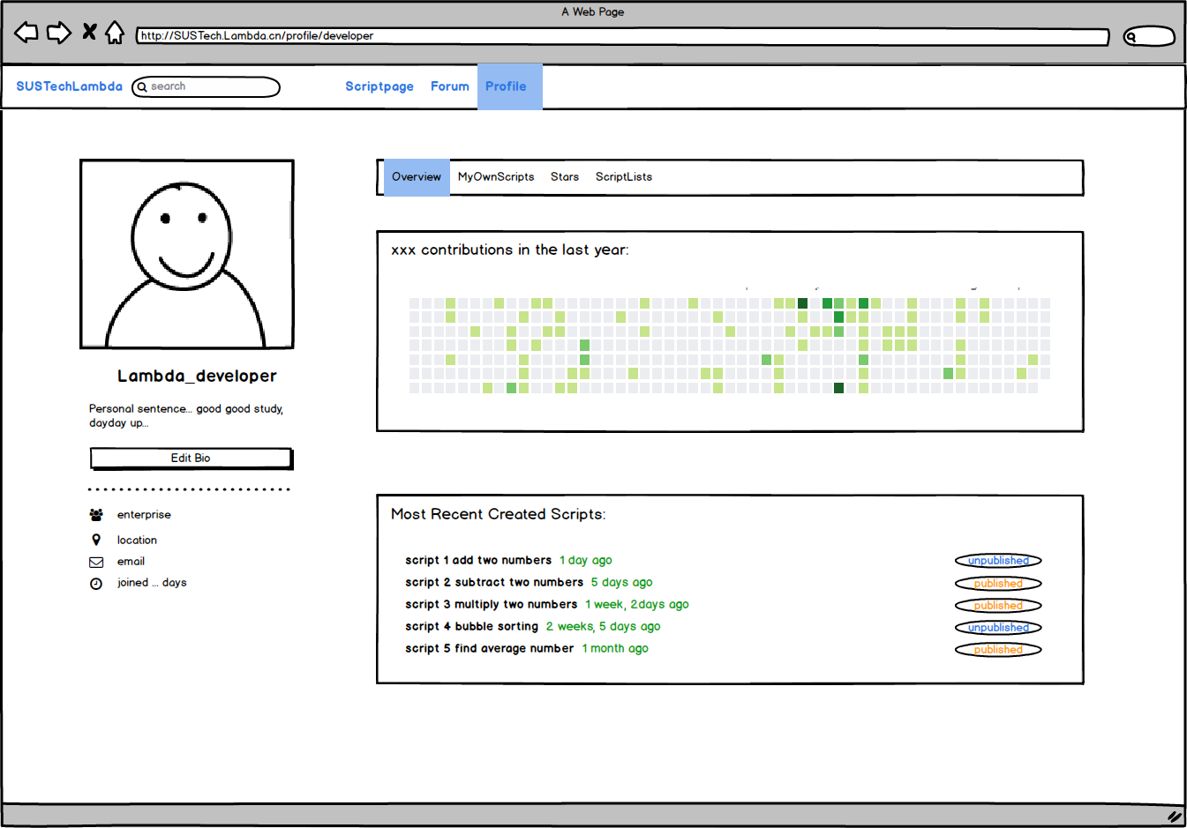
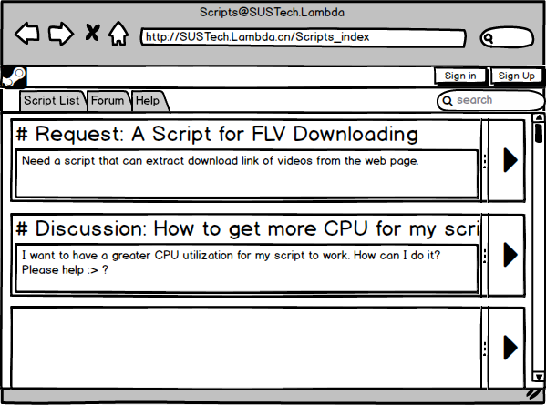
UI
Profile
Forum

Slide 11
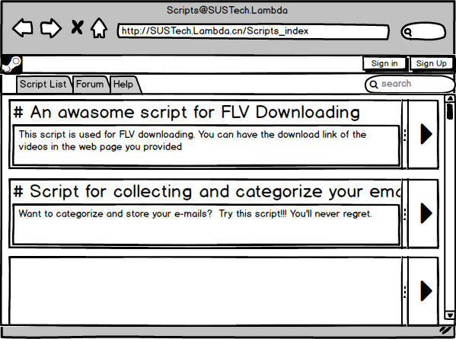
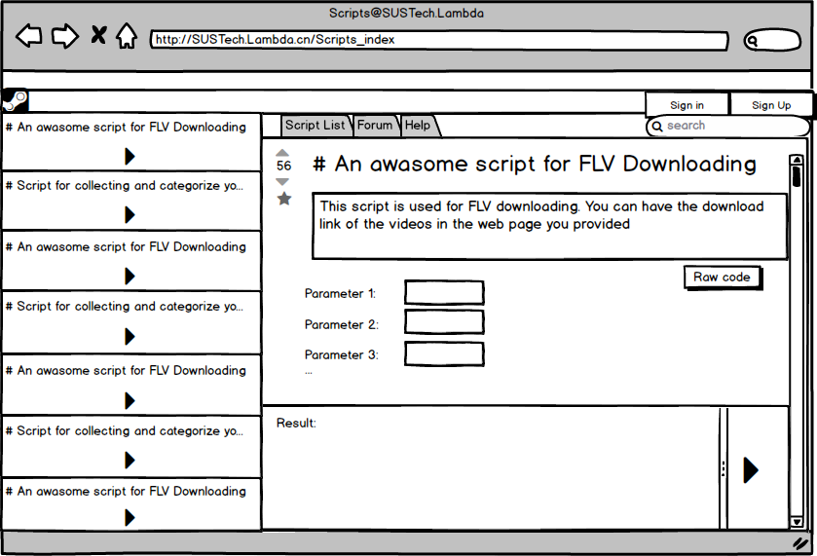
UI
script page
Script Detail page

Slide 12
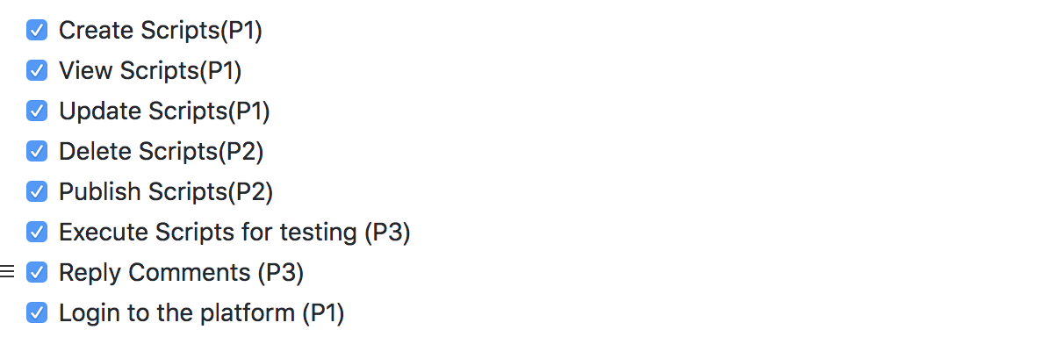
User story for script designer
国内外研究概况

Slide 13
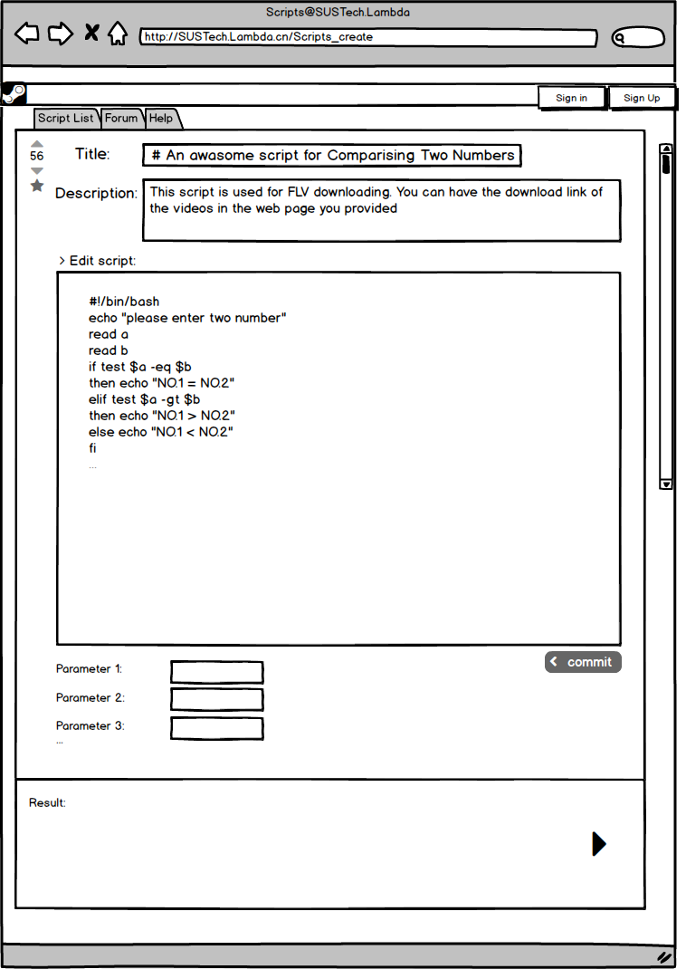
UI
creat script

Slide 14
Design
Document

Slide 15
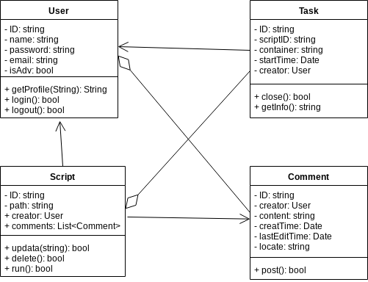
Class Diagram

Slide 16
Database
No SQL
using Mongodb

Slide 17
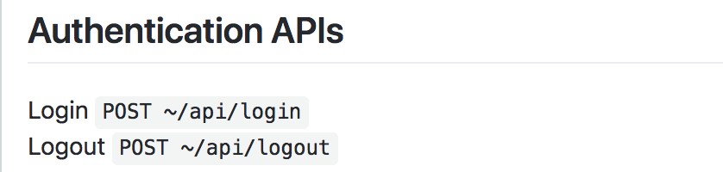
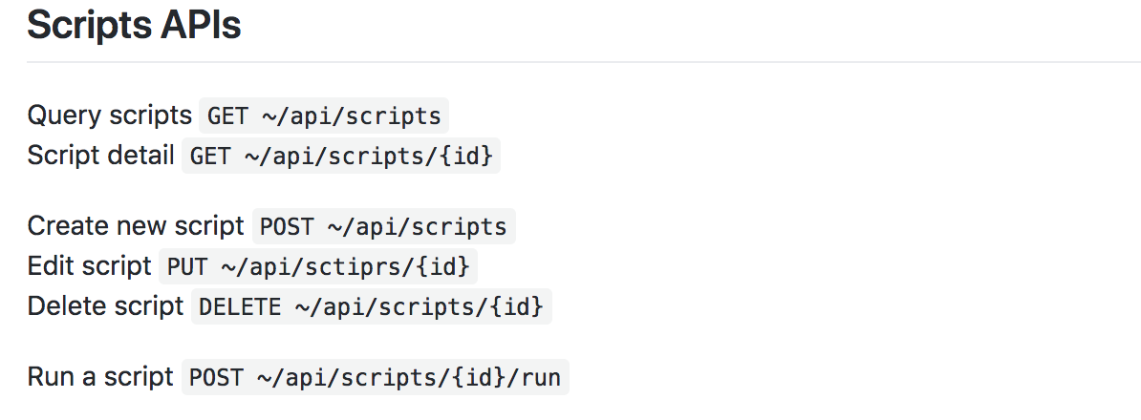
API Architecture

Slide 18
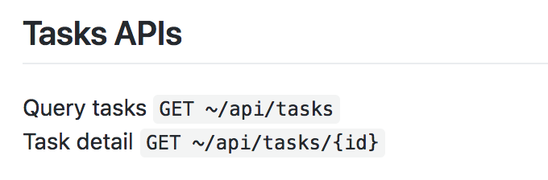
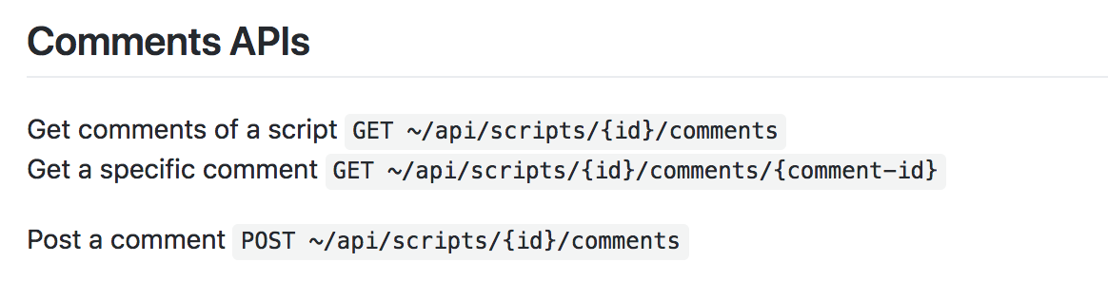
API Architecture

Slide 19
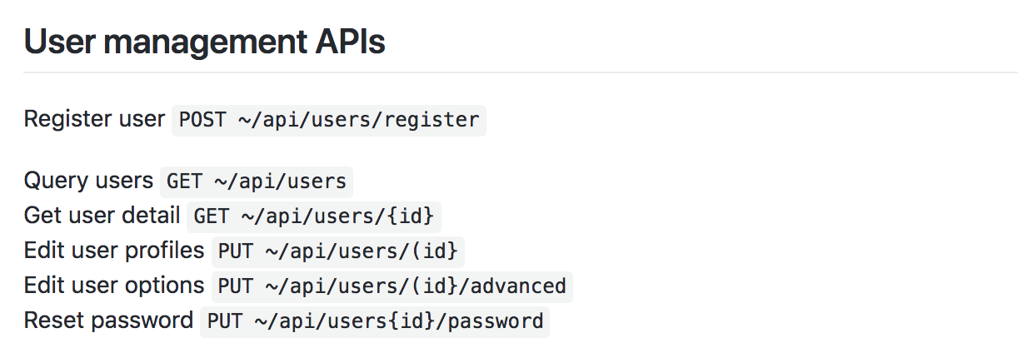
API Architecture

Slide 20
Time Line
Schedule

Slide 21
进度安排
Schedule
“Design”
Date range:
~Oct 10th
“Code review and connection”
Date range:
Dec 21th ~ Jan 1st
Step1
Step2
Step3
Step4
“Code implementation”
Date range:
Oct 11th ~ Dec 20th
“Test”
Date range:
Jan 1st ~

Slide 22
THANK YOU FOR WATCHING

